Slide 1
Capstone Project
Google Play Store Apps
Exploratory Data Analysis
By Nameet Dalal
t21253@students.iitmandi.ac.in

Slide 2
Why did I choose the google play store for analysis?
Google Play partners with developers to provide access to over 2 billion active monthly users. Distribution is free for developers who do not charge for their apps and games.
Companies may run beta focus groups, or app developers may receive feedback from testers and get certain amounts of reviews. We use this and some knowledge about the app to predict its success. Knowing the number of installs can help developers and business managers because they can predict the profit. This project's result may show the importance of reviews to apps in the market as it could be one of the determining factors for the number of installs.
Notes:
Google Play Store major contributor in market as compare to apple.
Its including many different apps, like books, magazines, music, movies, and television programs. Most are free (not charge for their apps)
Google have over 2 billion active monthly users
Knowing the number of installs it can help developers and business managers because they can predict the profit.

Slide 3
OVERVIEW OF EXPLORATORY ANALYSIS
Explore the Data Structure
Data Cleaning
Data Exploration
The goal of this study is to determine a useful way to understand what datasets are actually intended to represent.
Understand the structure of the dataset and clean data before analysis
Uncover initial patterns, characteristics, and points of interest using visual exploration
1
2
3

Slide 4

Explore the Structure of the Datasets
Play across different categories. We'll look for insights in the data to devise strategies to drive growth and retention. Let's take a look at the data, which consists of two files:
datasets/play_store_data.csv: This file contains all the details of the apps on Google Play. There are 13 features that describe a given app.
App: Name of the app
Category: Category of the app. Some examples are: ART_AND_DESIGN, FINANCE, COMICS, BEAUTY etc.
Rating: The current average rating (out of 5) of the app on Google Play
Reviews: Number of user reviews given on the app
Size: Size of the app in MB (megabytes)
Installs: Number of times the app was downloaded from Google Play
Type: Whether the app is paid or free
Price: Price of the app in US$
Content Rating: A content rating (also known as maturity rating) rates the suitability of TV broadcasts, movies, comic books, or video games to its audience.To show which age group is suitable to view media and entertainment.
Continue…
Notes:
Play_store_data.csv & play_store_data.csv

Slide 5
Explore the Structure of the Datasets
Genres: A category of artistic, musical, or literary composition characterized by a particular style, form, or content
Last Updated: Date on which the app was last updated on Google Play
Current Ver: Current Version means a version of the software that is currently being supported by its publisher.
Android Ver: Android versions (codenames) are used to describe the various updates for the open source Android mobile operating system.
datasets/user_reviews.csv: This file contains a random sample of 100 user reviews for each app. The distribution of positive and negative reviews in each category has been pre-processed and passed through a sentiment analyzer.
App: Name of the app on which the user review was provided. Matches the App column of the play_store_data.csv file
Translated Review: The pre-processed user review text.
Sentiment: Sentiment category of the user review - Positive, Negative or Neutral.
Sentiment Polarity: Sentiment score of the user review. It lies between [-1,1]. A higher score denotes a more positive sentiment.
Continue…
Notes:
5 features
file contains a random sample of 100 user reviews for each app
positive and negative reviews in each category which passed through a sentiment analyzer.

Slide 6
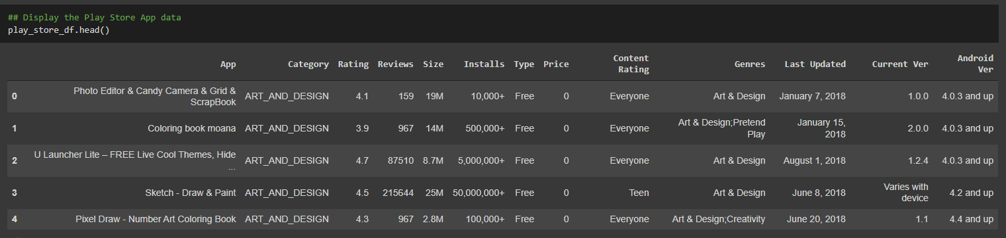
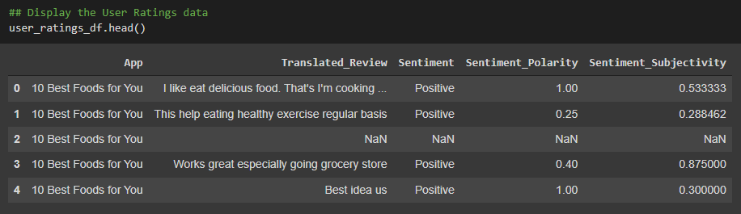
Explore the Structure of the Datasets
Notes:
Importing required packages and dataset

Slide 7
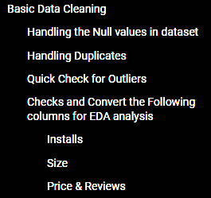
Data Cleaning
Data cleaning is the process of fixing or removing incorrect, corrupted, incorrectly formatted, duplicate, or incomplete data within a dataset.
Some time when combining multiple data sources, there are many opportunities for data to be duplicated or mislabeled. If data is incorrect, outcomes and algorithms are unreliable, even though they may look correct.
There is no one absolute way to prescribe the exact steps in the data cleaning process because the processes will vary from dataset to dataset. But it is crucial to establish a template for your data cleaning process so you know you are doing it the right way every time.
Continue…
Notes:
3.1 Handling the Null values in the dataset:
3.2 Handling Duplicates: 8
3.3 Check for the Outliers: 9
3.4 Check and Convert the Following columns for EDA analysis: 9
3.4.1 Installs. 9
3.4.2 Size. 9
3.4.3 Price & Reviews. 10

Slide 8
Data Cleaning
Handling the Null values in dataset
The first step is to detect the count/percentage of missing values in every column of the dataset. This will help us an idea about the distribution of missing values.
Handling Duplicates
Removed unwanted observations from your dataset, including duplicate observations or irrelevant observations.
02
01
03
Converted the few of columns for EDA analysis
As some of feature column are non-numerical value so its converted the categorical variables the into numerical for ease analysis.
Quick Check for Outliers
On studying the dataset further, it was found that there was a data with some kind of weird anomaly. Let us find out the row in the data and purge it.
04
Notes:
Handling the Null values in the dataset: Feeding missing data could lead to wrong prediction or classification. Hence it is necessary to identify missing values and treat them and Dropping them
Since the ratio of missing values for the rest of the columns is less (<0.05), we proceed to fill these with the mode values instead of dropping these rows.
3.2 Handling Duplicates: Perform some checks and find that there are 2644 duplicated entries in ‘Play Store Data’ dataset from the "App" column. Hence, dropped the duplicates from the "App" column.
3.3 Check for the Outliers: entry of our dataset is having a Rating of 19.0 which is way higher than the maximum rating of 5.0. Hence, we are removing this row to make our analysis easier.
3.4 Check and Convert the Following columns for EDA analysis: non-numerical value so I have converted the categorical variables the into numerical for ease of analysis.
Installs. 9
Size. 9
3.4.3 Price & Reviews. 10

Slide 9
Exploratory Data Analysis (EDA)

Slide 10
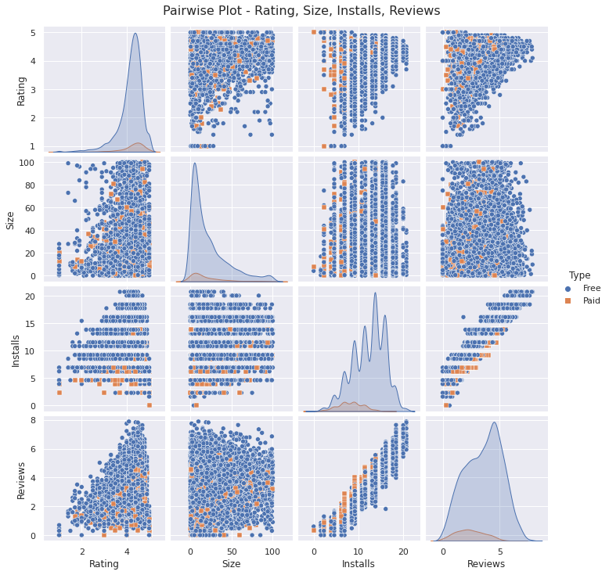
BIVARIATE ANALYSIS

Slide 11
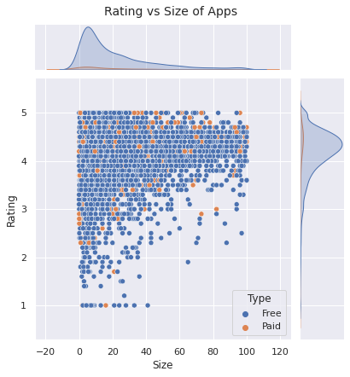
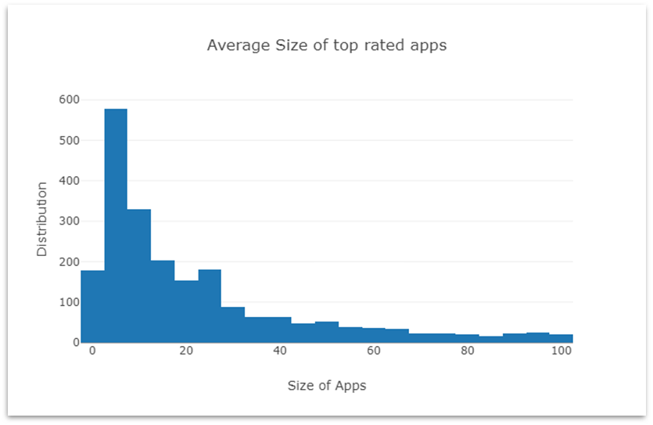
Does the size of the app affect the ratings and number of installs?
We find that the majority of top-rated apps (rating over 4) range from 2 MB to 20 MB. We also find that the vast majority of apps are free as compared to paid apps.
Most top rated apps are optimally sized between ~2MB to ~40MB - neither too light nor too higher in size.

Slide 12
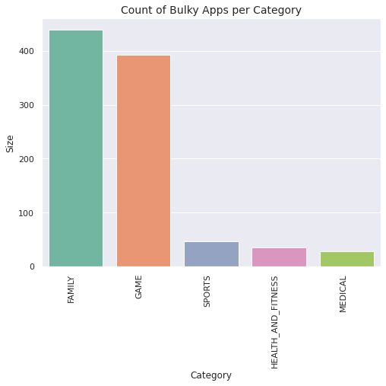
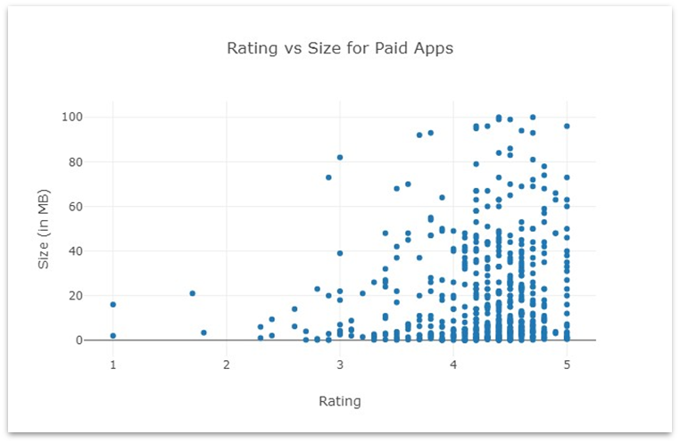
2. Which category has the higher in size apps and how are they rated?
Most higher in size apps ( >50MB) belong to the Game and Family category.
The higher in size apps are fairly highly rated indicating that they are higher in size for a purpose.

Slide 13
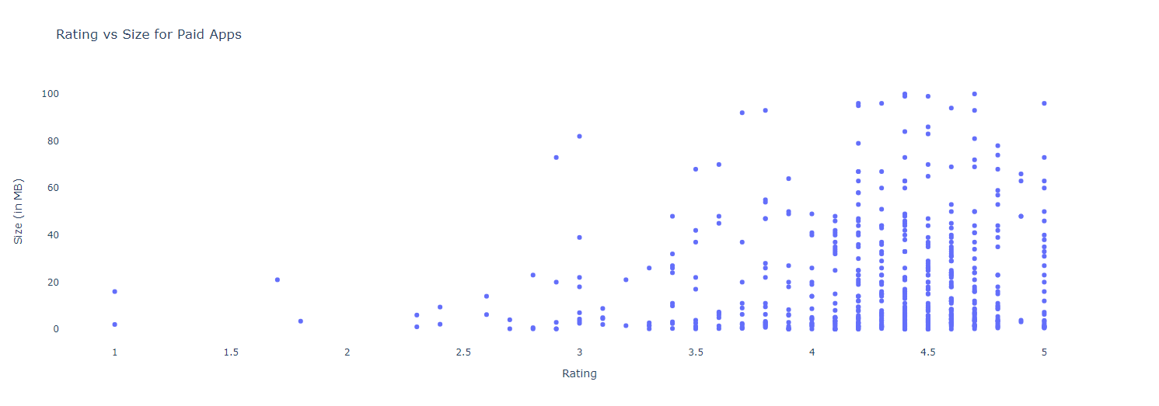
3. Does the sizes of paid apps and free apps vary?
Majority of the paid apps that are highly rated have small sizes. This means that most paid apps are designed and developed to cater to specific functionalities and hence are not in higher size.
Users prefer to pay for apps that are light-weighted. A paid app that is higher in size may not perform well in the market.

Slide 14
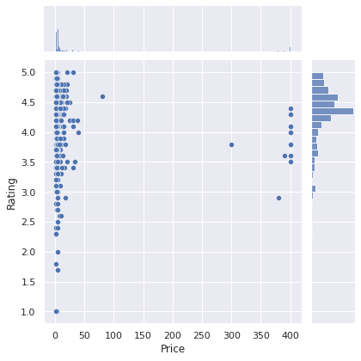
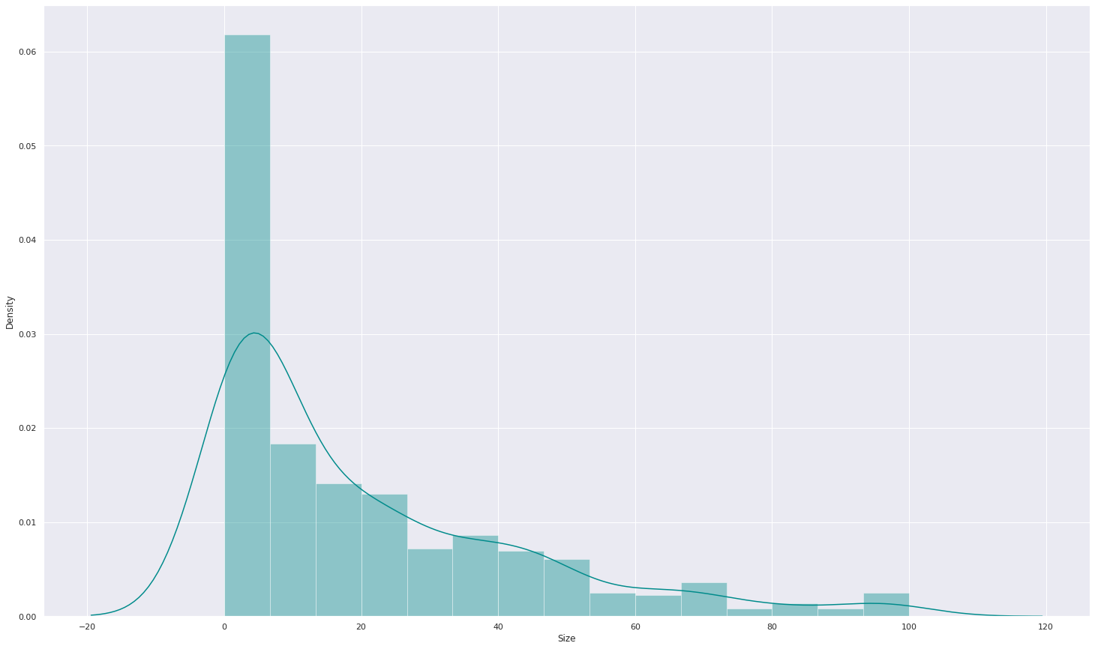
4. Does the App prices affect rating and number of installs?
Most top rated apps are optimally priced between ~1 to 30 . There are only a very few apps priced above 20$.

Slide 15
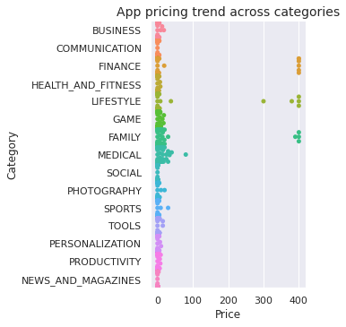
5. How is the Price trend across category?
The cheaper apps are also more popular which is supported by the fact that 90% of paid apps are less than $10 and 80% of apps are less than $5.
Categorically, the most expensive apps are Family, Finance and Lifestyle apps which would suggest that people are willing to pay more for these apps, possibly due to a belief in a reliability or highly specialized applications.

Slide 16
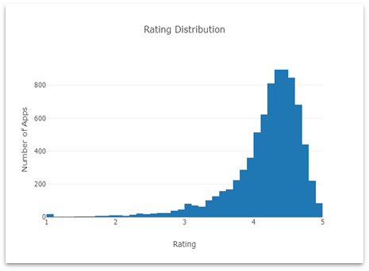
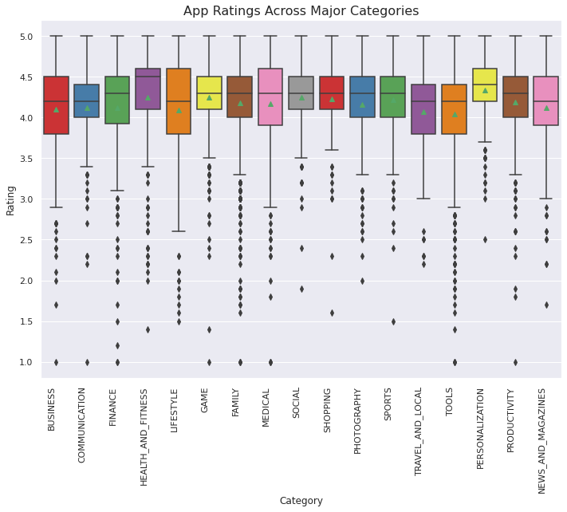
6. How is the Rating Distribution?
The rating distribution revealed that most apps perform reasonably well with an average rating of 4.17.
We broke down the average rating by category to check if any category performs exceedingly good or bad.
The Health and Fitness is the best apps and other apps with 50% apps having a rating greater than 4.5. Interestingly, half of the Dating apps have a rating lower than the average.

Slide 17
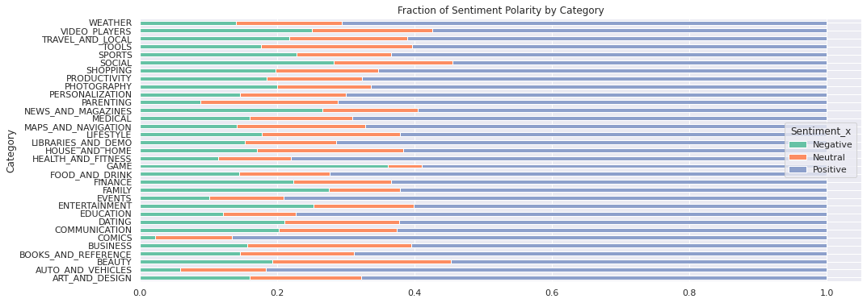
7. Basic Sentiment Analysis from User Reviews dataset
We plotted the fraction of positive, negative and neutral reviews for each category and observed that the Health and Fitness apps perform the best with more than 85% positive reviews.
On the other hand, Game and Social apps have a higher fraction of negative reviews.

Slide 18
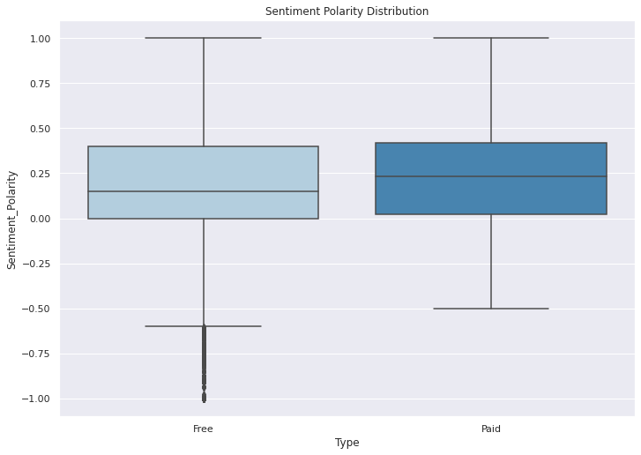
7. Sentiment Polarity By Type (Free/Paid)
We compared the reviews between free and paid apps and found that people are harsher towards free apps whereas users are more tolerant when they are paying for it.

Slide 19



Aha! My discoveries
What did you learn after explore and analyze?
Size: Highly rated apps were optimally sized between 2MB to 40 MB. Paid apps with specific functionality were lighter
Price: Free apps outperform paid apps If an app is paid, the likelihood of it being popular is higher if it’s priced under $10
Rating: Positive relation between installs and rating. However, highly installed apps are not always highly rated
Reviews: People tend to review harsher for paid apps

Slide 20
Conclusion
Average rating of (active) apps on Google Play Store is 4.17.
Users prefer to pay for apps that are light-weighted. Thus, a paid app that is higher in size may not perform well in the market.
Most of the top rated apps are optimally sized between ~2MB to ~40MB - neither too light nor too heavy.
Most of the top rated apps are optimally priced between ~1$ to ~30$ - neither too cheap nor too expensive.
Medical and Family apps are the most expensive and even extend upto 80$.
Users tend to download a given app more if it has been reviewed by a large number of people.
Health and Fitness apps receive more than 85% positive reviews.
Game and Social apps receive mixed feedback 50% positive and 50% negative.

Slide 21
Thank You

